Slide 1
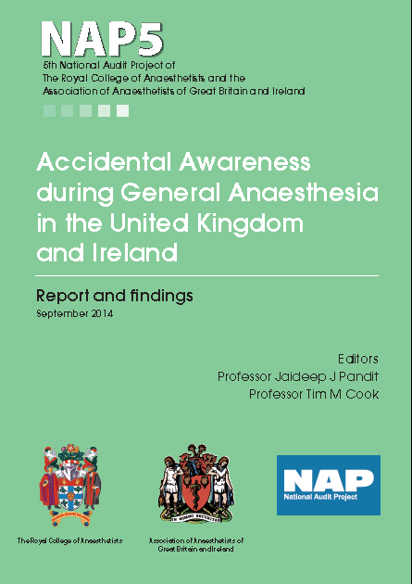

Slide 2
Introduction and Methods

Slide 3
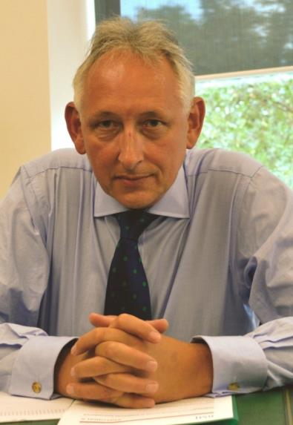



A collaboration

Slide 4
Contributors
All anaesthetists
UK and Ireland

Slide 5
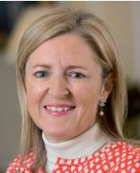
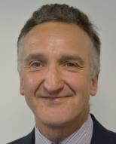


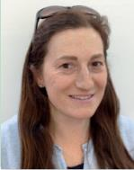

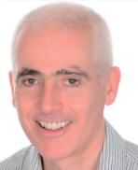


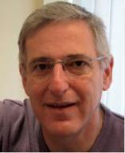

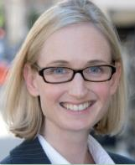



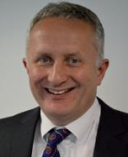


Contributors – core panel
Panel

Slide 6

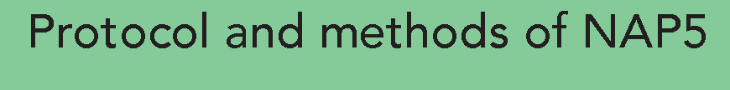
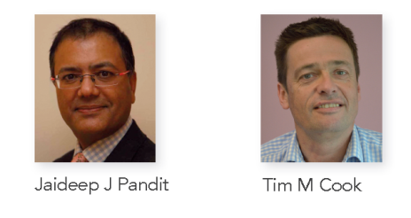

Slide 7
Workstreams
Baseline survey
Irish baseline survey
Irish activity survey
UK activity survey
(Psychological follow-up – tbc)

Slide 8
Methods
Broadly as for NAP3, NAP4
- All UK NHS hospitals
Service evaluation
I year registry
New for NAP5
- Inclusion of Ireland
- Negative reporting
- Collaboration AAGBI + RCoA

Slide 9
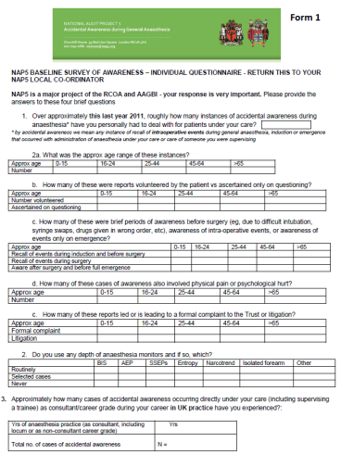
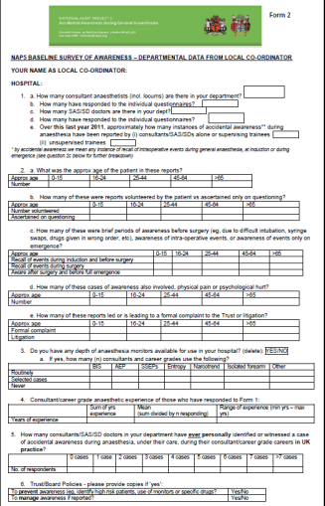
Individual and department forms
Baseline survey

Slide 10
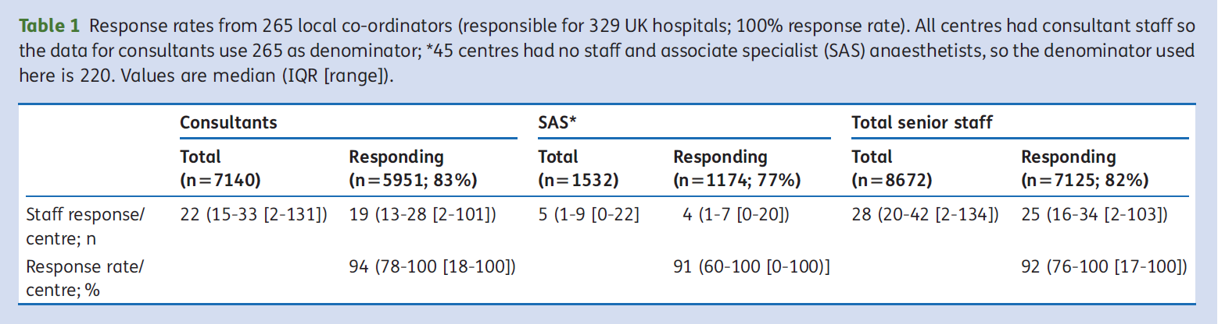
Data from 100% UK hospitals
Replies from 92% senior UK anaesthetists

Slide 11
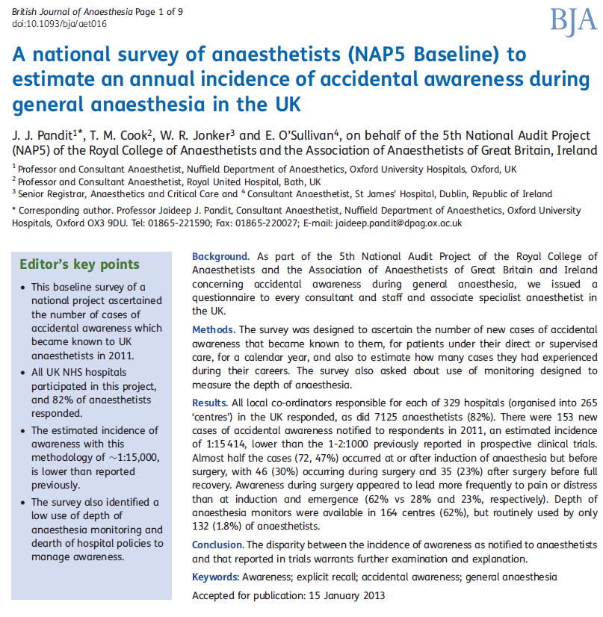
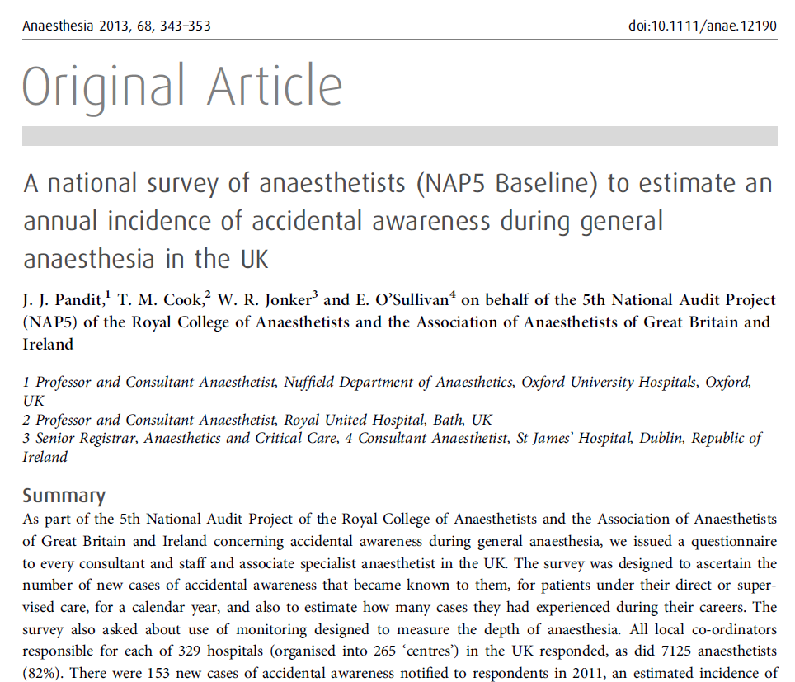
April
2013
153 reports of AAGA in 2011
Reports ≈ 1:15,000 GAs
Limited use of DOA
Minimal AAGA pathways

Slide 12


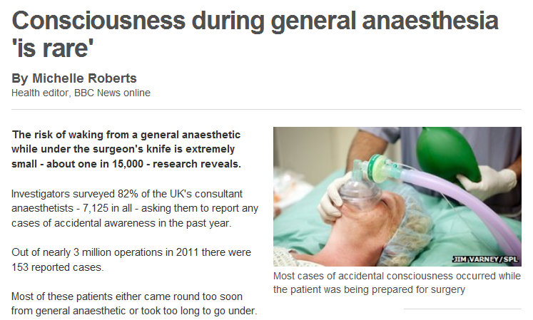
>100 website reports
http://www.bbc.co.uk/news/health-21742306

Slide 13

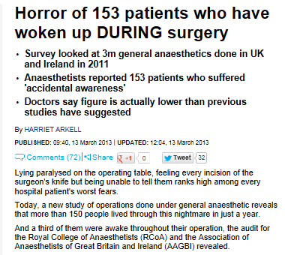


Slide 14
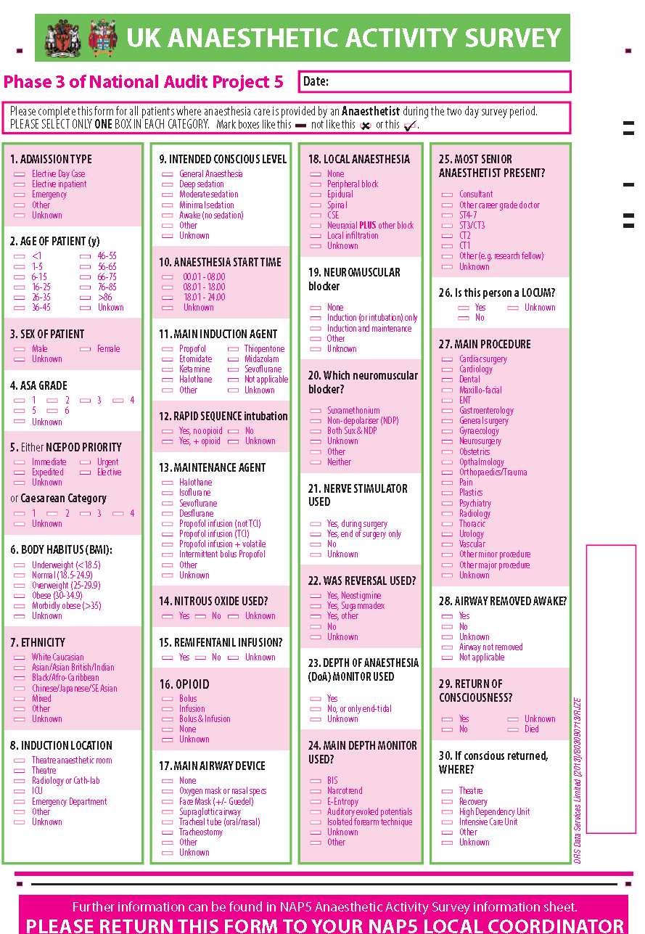
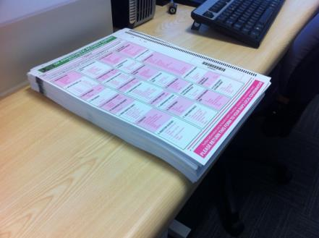
UK Activity survey

Slide 15
UK Activity survey
100% returns
>20,000 cases

Slide 16
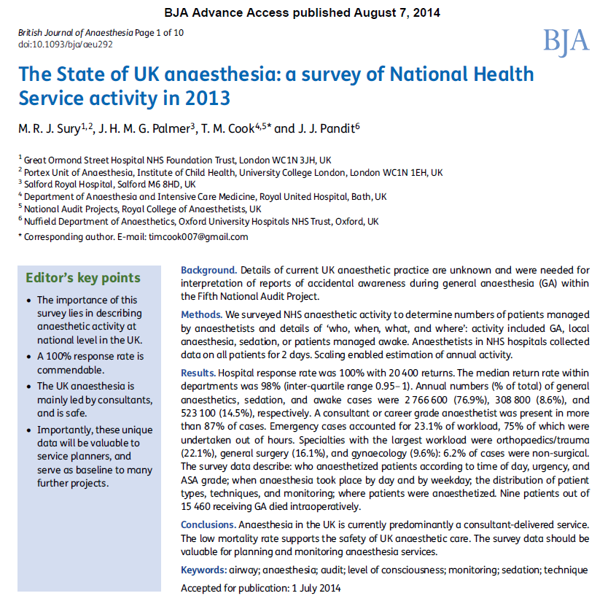
NAP5 denominator

Slide 17
The registry - inclusion criteria
a new patient report
made between 1 June 2012 - 31 May 2013
that they had been aware for a period of time when they expected to be unconscious.

Slide 18
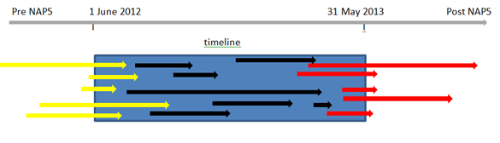
Historical cases captured to balance future missed cases

Slide 19
The NAP firewall
i Anonymous report to administrator
ii Verification questions
iii Automated remote release of username and password
iv Mandated password change at first log on
v Report to secure, encrypted website (no identifiers)
vi Completed report mailed to NAP lead
vii Screening of reports for identifiers
Vii Report for review

Slide 20
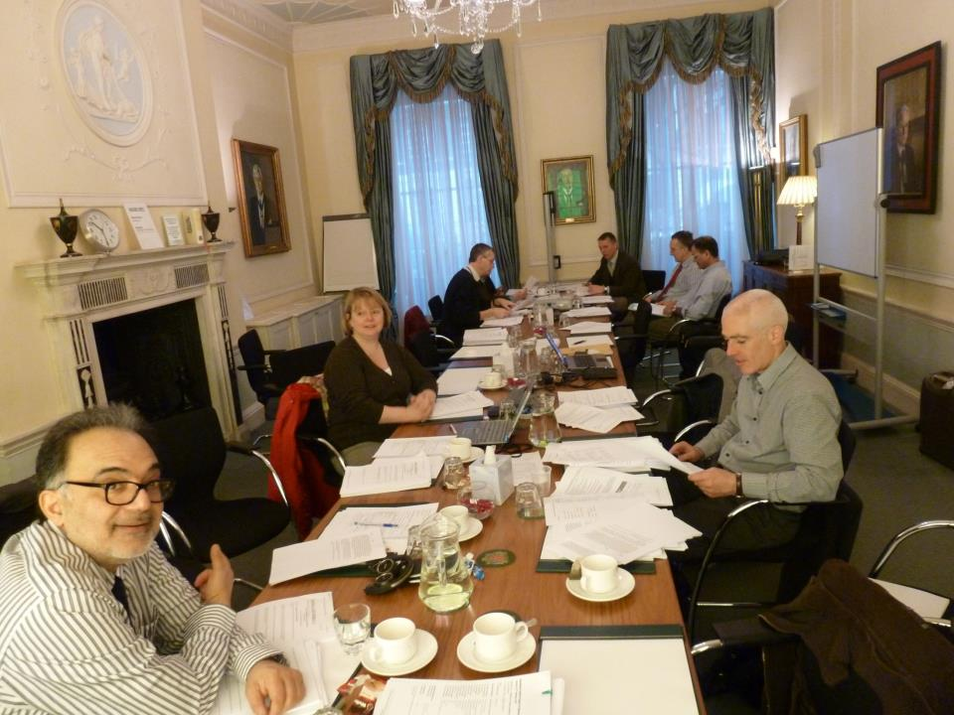

Slide 21
NAP5 panel
Including …..
  Patient representatives
  President AAGBI
  2 council members RCoA
  3 council members AAGBI
  President CAI
  Editor-in-Chief BJA
  President SIVA
  President OAA
  Psychologists, psychiatrists
  5 Profs etc etc

Slide 22
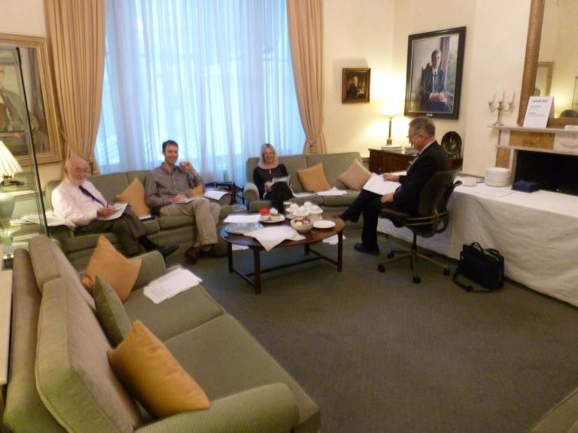
First review by min 4

Slide 23
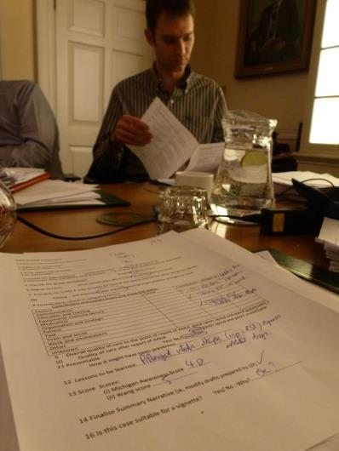
Structured output for each case

Slide 24
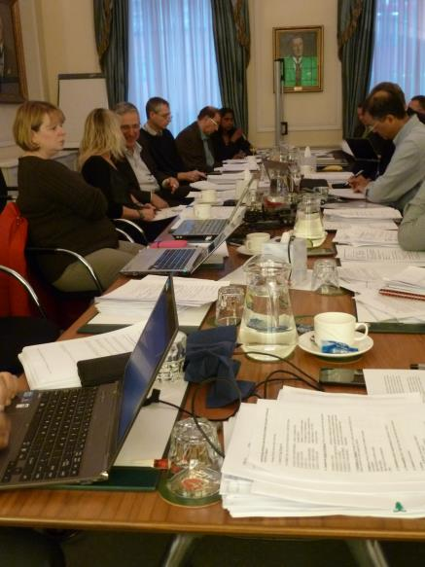
2nd review by larger group- moderation

Slide 25
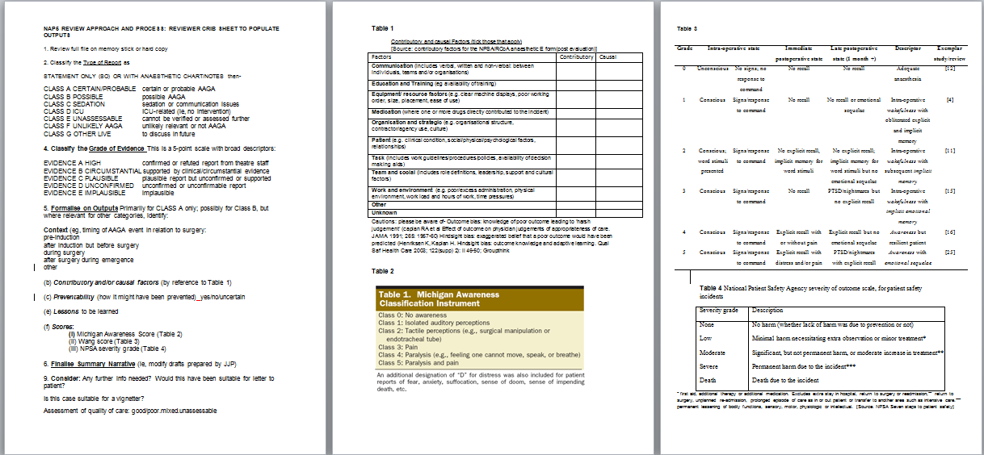
Structured outputs

Slide 26
Aware of…..
Outcome bias: knowledge of poor outcome leading to ‘harsh judgement’
  Caplan RA et al Effect of outcome on physician judgements of appropriateness of care. JAMA 1991; 265: 1957-60
Hindsight bias: exaggerated belief that a poor outcome would have been predicted
  Henriksen K, Kaplan H. Hindsight bias: outcome knowledge and adaptive learning. Qual Saf Health Care 2003; 122(supp) 2): ii 46-50.
‘Group think’

Slide 27
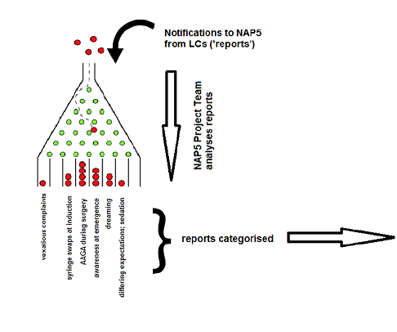

Slide 28
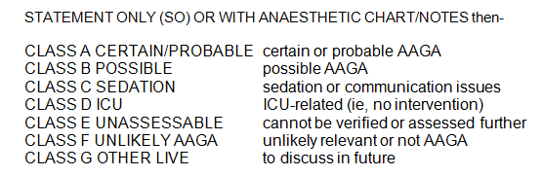
Classification: Type of AAGA

Slide 29
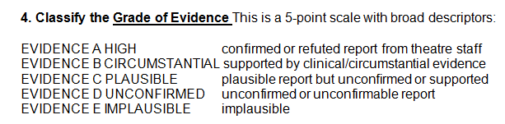
Classification: Evidence

Slide 30
Classification: patient experience

Slide 31
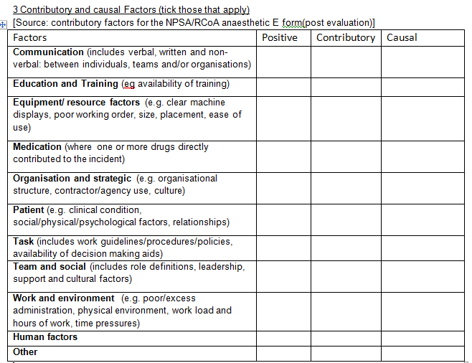
Classification: Contributory/ mitigating factors

Slide 32
Classification
Quality of care pre-AAGA
Quality of care post-AAGA report
good/poor/good and poor/unassessable
Preventability
yes/no/unassessable
Wang M. 2009

Slide 33
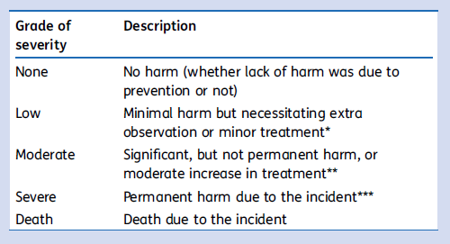
Classification: Degree of harm
NPSA Glossary - Root cause analysis (2009)

Slide 34
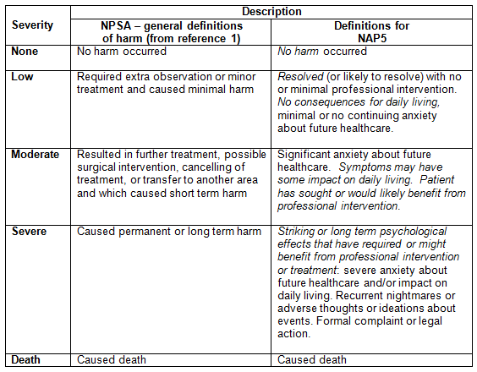
Classification: Degree of harm

Slide 35
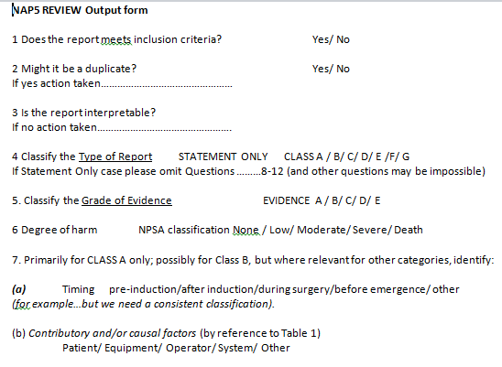

Slide 36
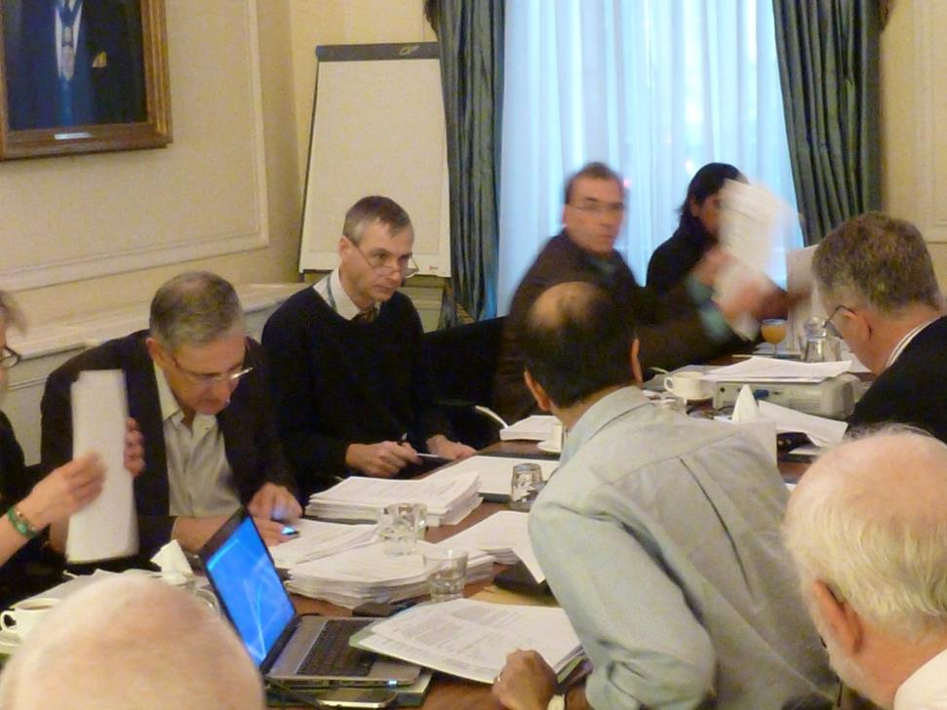

Slide 37
Summary of review process
structured expert dual consensus review
with structured output
expert exploration of the truth:
not ‘the truth’

Slide 38
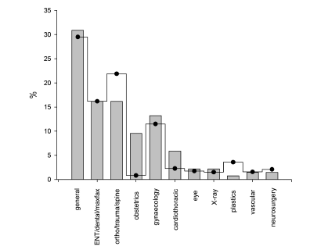
Main results and incidences

Slide 39
269 UK centres
108 filed zero returns over the year
161 (60%) centres had a report
471 requests to upload data
341 logins issued (130 inadmissible)
321 logins used (20 unused)
300 accepted (21 judged inadmissible)

Slide 40




Slide 41
What’s inadmissible? (1)
- complex medical history kidney disease, electrolyte imbalance
- anaesthetic uneventful – included NMB and nerve stimulator
when fully awake, patient complained of leg and arm weakness that lasted 12 h. The patient was very distressed and experienced sleep disturbance for several weeks
no report of ‘awareness’ → inadmissible

Slide 42
Main focus is on certain/probable and possible reports
We can compare % Activity Survey vs AAGAs ‘relative risk’ or ‘hazard ratio’
In following graphs, proportions
  Lines = Activity Survey
  Bars = AAGA

Slide 43
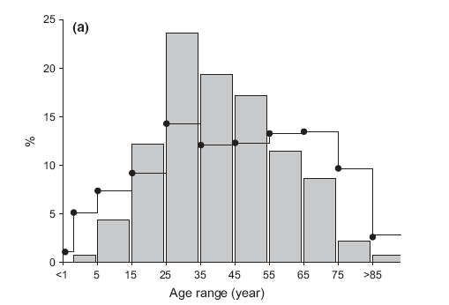
Age
AAGA most in young/middle age adults (viz. Baseline)

Slide 44
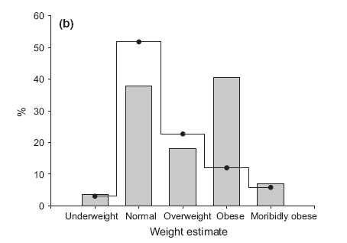
Weight
AAGA more in obese

Slide 45
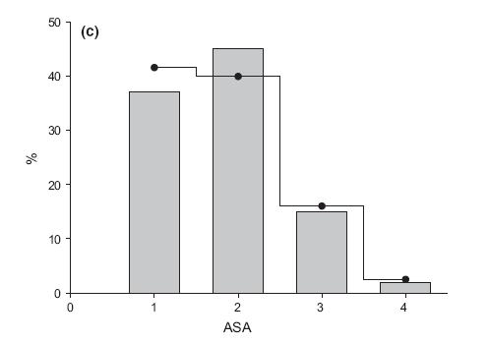
ASA
Not influential (ASA 3/ 4 more sensitive to drug; get less drug?)

Slide 46
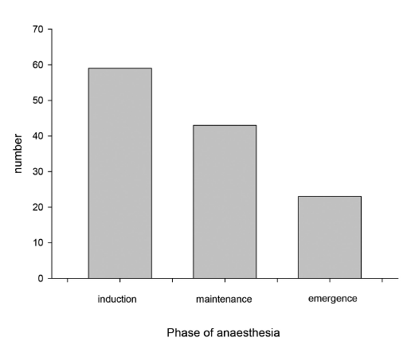
Phase of anaesthesia
Most common (75%) in dynamic phases

Slide 47
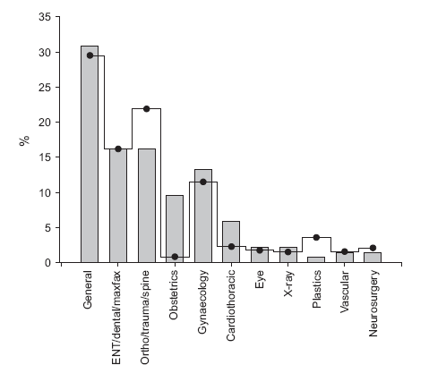
Types of surgery
Obstetrics and cardiothoracic over-represented…

Slide 48
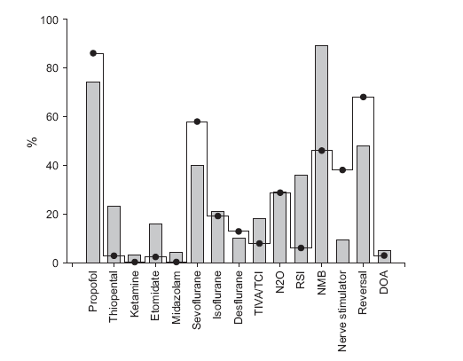
Modes of anaesthesia
Full profile

Slide 49
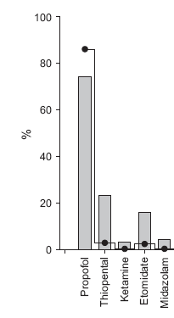
Induction
Thiopentone:
RSI/OB
3% of all inductions
87% if RSI inductions
Etomidate?
RSI
(not used so much;
unfamiliarity?)

Slide 50

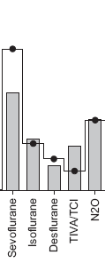
Maintenance
TIVA a risk?
N₂O ‘neutral’
(less volatile used, so net
effect neutral?)

Slide 51

NMB
The ‘unholy trinity’ that leads
to AAGA
- NMB
- no nerve stimulator
- no reversal

Slide 52
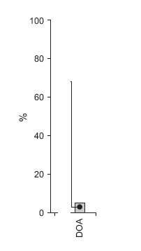
DOA
DOAs not relevant to AAGA
in the UK (used in just 2.8% GA)
Use in Activity Survey 2.8%
Use in AAGA cases 4.3%
→ over-represented x 1.5
(superficially ‘a risk’ - but see later)

Slide 53
“Incidence”
Incidence of what?
AAGA highly heterogeneous
Different methods look at different things
Brice = ~1:600
Baseline = ~1:15,000
NAP5 main study 1: 19,000 - aggregate

Slide 54
Incidence subgroups…
All patient reports, valid, substantiated or not (n = 471)
1: 6,000

Slide 55
Admissible patient reports (n = 300)
1: 12,000

Slide 56
Certain/probable or possible only (n = 141)
1: 20,000

Slide 57
When no NMB used
1 : 136,000
When NMB used
1: 8,200

Slide 58
Cardiothoracic
1 : 8,000 (same as NMB)
Caesarean section
1: 670 (close to Brice)

Slide 59
Paediatric
1: 61,000
AAGA reports after sedation by anaesthetists
1: 15,000
(AAGA more common after sedation than GA)

Slide 60
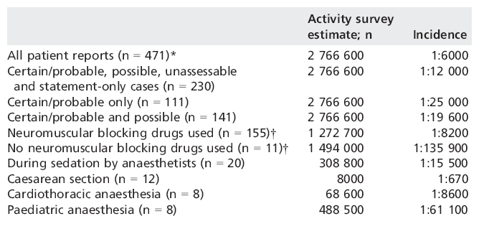
..all incidences

Slide 61
No single ‘incidence’
Brice methods differ from NAP5
NAP5 main study differs from Baseline
Within NAP5, differences in incidence between categories
Different methods look at different things
Different entities differ in degree to which detected by methods
These differences need researching

Slide 62
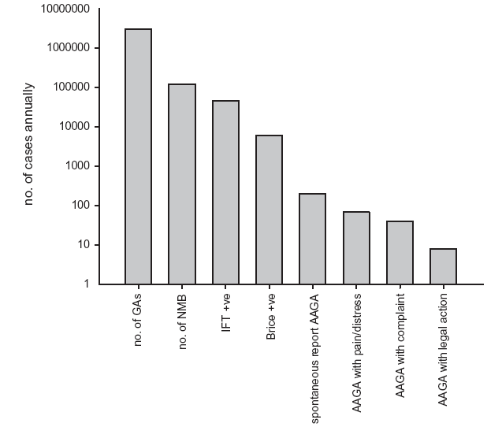
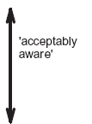


Slide 63
Conclusions
AAGA risks (overview) appear to include:
Middle age
Obesity
Thiopentone
RSI
Obstetric and cardiothoracic surgery
NMB, especially with no monitoring or reversal
TIVA/TCI (to be discussed)
DOA monitoring (to be discussed)

Slide 64
Conclusions: incidence
While Brice = 1:600, NAP5 mean = 1:19,000
However:
From 1: 135,000 (no NMB) to 1:8,000 (NMB to 1: 670 (LSCS)
No single ‘incidence’ as this is highly context-specific

Slide 65
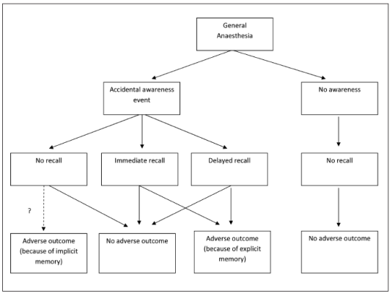
Patient experiences of AAGA

Slide 66
A study of patient reports
Not all AAGA is remembered
Even light sedation prevents recall on recovery
Patients can be responsive during GA but remember nothing on recovery
From Russell (1993): 72% IFT response, 0% postoperative recall

Slide 67
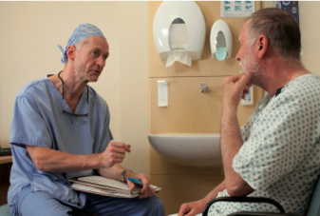
Memory for AAGA
Previous studies have tried to elicit recall by repeatedly interviewing patients using the modified Brice procedure
1-2 per 1000
1 in 3 reported > 1 week
Wide variation in patients’ experiences of AAGA
Auditory perceptions are common, as are feelings of helplessness and fear

Slide 68
From AAGA to reporting
Intra-operative consciousness
Subjective interpretation
amnesia
Intra-operative recall Decision to discuss
trivial
Report to medical staff
Will I be believed?
too distressing
don’t want to complain:
gender, personality,
culture, consequences
for treatment,
consequences for
anaesthetist
meaning?
dream?
Is it my fault?
How will they react?
delayed recall
Litigation?
Apology?
Altruism
motivation
motivation
Notes:
NAP5 is a poor indicator of incidence

Slide 69
How memory works
Why so few?
Why the delay?
Can we trust them?

Slide 70

Why so few memories?
Memories are reconstructed not replayed
Need to understand the experience:
Bransford & Johnson (1972)
Need to know source of the memory (otherwise imagination or dream)
Need to have unique retrieval cues

Slide 71
Why is recall delayed?
Memories are over-written by more recent memories
Shared retrieval cues
AAGA patient regains consciousness at least twice

Slide 72
Can we trust reports of AAGA?
False memories can be created by inserting erroneous information
Reports of dreaming are different: pleasant content, unrelated to DoA, reported soon on emergence
- However none of these factors likely relevant to reports of AAGA in NAP5

Slide 73
NAP5 results
141 certain/probable or possible cases (1:20,000 cf 1:600 with Brice)
43% reported to another anaesthetist, 26% to anaesthetist who provided care, 15% to recovery or ward nurses
34% reported on day of AAGA, 11% day after, 52% within a week
but 25% reported after a year or more

Slide 74
Trustworthy?
Certain/probable and possible reports were supported by anaesthetic notes
Reports classed as unassessable or unlikely were typically confused about timing of peri-operative events or too sparse to interpret
Panel judged there were no malicious reports

Slide 75
Patients’ experiences
Wide variety of experiences
Only one report (‘unlikely’) of a patient interpreting dream as AAGA
Median 2 experiences
Range 0 (‘being awake’) to 8
% certain/probable and possible cases

Slide 76
Neutral reports
A patient mentioned to the surgeon overhearing a conversation between surgeons regarding the position of incision, and quoted exactly what had been discussed. The conversation had taken place in the middle of surgery, for a few seconds. The patient was interested rather than concerned.
A patient whose trachea was difficult to intubate recalled anaesthetists trying to “get the tube down and struggling” but was reassured by their care and thanked them. The patient was not distressed and thanked the anaesthetists for their care and attention.

Slide 77
Distress
Pain 18%
Distress 53%

Slide 78

Distress
53% distress
Common in, but not restricted to, cases with pain or paralysis

Slide 79

Distress
Distress during AAGA was very strongly associated with long-term psychological harm

Slide 80
Severe distress
A patient reported auditory and tactile recall of laryngoscopy and intubation and the start of surgery. The patient wanted to scream but could not move or speak.
The patient could hear everything but felt no pain, only some touch when somebody lifted their leg, and something being drawn along the leg with a pencil (as did happen), some humming, and then with no pain, an incision.

Slide 81
Sensations vs phase
Induction Touch (e.g TT)
Paralysis
Maintenance Paralysis
Pain
Emergence Paralysis

Slide 82

Distress vs duration of experience
No clear
association

Slide 83
Distress vs duration of experience
Distress vs duration of experience
median IQR range
No distress 60 15-300 3-10,800
Distress 180 60-600 5-3,600
P= 0.41

Slide 84

Michigan vs distress
- clear relation

Slide 85
Michigan vs Distress
- clear relation
Caveat-
Michigan 1-2 ≠ no distress

Slide 86
Duration and delay
No clear relationship between the perceived duration of AAGA and psychological impact
Brief experiences could be severely distressing
No clear relationship between reporting delay and impact
Experiences reported after a delay were no less distressing than those reported immediately

Slide 87

Delays in reporting vs distress
No clear
association

Slide 88
Distress
Pain 18%
Distress 53%

Slide 89
Causes of distress
Mostly paralysis…….
…due to paralysis 67%
…breathing difficulty 15%
…fear of death 3%
…perception of having died 2%
…pain w/o paralysis 11%
…pain then paralysis 6%

Slide 90


Slide 91
Distress - inhomogeneity
Not all pain and paralysis caused distress…
….distress was seen with only auditory or tactile sensation (25%)

Slide 92

AAGA w/o distress
xx
A patient recalled and quoted a surgeon’s conversation mid operation…..they expressed interest rather than concern
After a DTI the patient recalled intubation and the anaesthetist struggling to get the tube down…. They thanks them for their care and attention

Slide 93

Distress without pain/paralysis
Awareness of intubation (auditory and tactile)… patient wanted to scream…..patient described ‘being imprisoned on their body’

Slide 94

Distress without pain/paralysis
After tactile AAGA the patient reported ‘being alive only in their head’ and ‘as if being in a crypt’…..a psychotic episode and PTSD followed

Slide 95
Distress modulation
Lack of understanding
- increased distress
Comprehension or explanation
- decreased distress

Slide 96
Understanding and reassurance
During AAGA
A patient reported hearing voices, and experiencing paralysis and abdominal pain. Wanted to ask for painkillers but could not speak. The pain was unpleasant; but the paralysis was not a great worry because the patient knew “you were supposed to be paralysed during the operation”. The patient was later not worried about having another anaesthetic.

Slide 97
Understanding and reassurance
A patient was given suxamethonium before induction inadvertently. The anaesthetist immediately recognised the error and induced anaesthesia. The patient experienced paralysis, was afraid they were dying from a stroke and had flashbacks for 2-3 days afterwards. However the patient was very reassured by the anaesthetist’s immediate explanation, "I know what’s happening and I can fix it", during the critical event and had minimal long-term sequelae.

Slide 98
Understanding and reassurance
After AAGA
A patient recalled hearing voices, seeing bright lights not being able to move or communicate and being terrified, thinking they were going to die. The patient went home and mentioned it to their family and was reassured when they all apparently had a report of awareness "…it happens to all my family – we all wake up. Please can you give me a bit more?”

Slide 99
Understanding and reassurance
After AAGA
Neuromuscular blockade was inadvertently administered without induction agent. The anaesthetist questioned the patient on recovery, who said that they had “felt and heard everything”, felt the tube going in and could not breathe, which was distressing. The anaesthetist apologised, and the patient had no adverse sequelae.

Slide 100
Lack of understanding
“thought I was dying”
“thought I had died”
“felt alive only in my head”
“thought they would be paralysed forever”
“felt I was in a crypt”

Slide 101

Comprehension…
“urgent abdominal surgery…..
lights, voices, paralysis and pain….
wanted to ask for pain relief…..
paralysis was not a great concern….
the patient knew you were supposed to be paralysed during the operation

Slide 102
Research implications
Why is there a delay in reporting memories of AAGA?
  Are AAGA memories overwritten by memories of recovery?
  Are they hard to recall because partial and disconnected?
  Does it take time for patients to come to terms with their experience and feel able to discuss it?
Does repeated questioning (Brice) help patients retrieve genuine AAGA memories and allow faster intervention?
Can better psychological support mitigate impact of AAGA?

Slide 103

Recommendations

Slide 104

The psychological consequences of AAGA

Slide 105
Sequelae
Captured early
? Missed cases
? Some resolved
42% moderate / severe sequelae
51% of those with paralysis/pain
25% of those with auditory / tactile

Slide 106
Sequelae
Flashbacks
Nightmares
Hyperarousal (new anxiety, sleep disturbance)
Avoidance (of hospitals, lying flat)
Features of PTSD

Slide 107


Michigan vs sequelae

Slide 108

Delay in reporting vs sequelae
Class A/B
No clear
association

Slide 109


Delay in reporting vs sequalae
Class A/B
Statement only
No clear
association

Slide 110

Delays in reporting vs sequelae
No clear
association

Slide 111


Duration vs sequelae
Class A/B
Statement only

Slide 112

Distress vs Sequelae
Clear association

Slide 113
Distress vs Sequelae
Sequelae
79% of patients with distress
3% of those without distress
(odds ratio 121)

Slide 114

Distress vs sequelae (SO)

Slide 115
NAP5 case example 1: catastrophic misattribution
After incomplete reversal of neuromuscular blockade a patient reported being unable to talk or to move, the feeling of a tight chest “I was very scared, I thought I will be paralysed and unable to move [for the rest of my life]. It was a really bad experience.” The patient developed anxiety and fear about anaesthesia, needing psychological support.

Slide 116
Cognitive Model
Ehlers & Clark, 2000
Mental defeat during trauma
Trauma
Poorly elaborated, incomplete context, absence of conceptual processing, perceptual processing only
Trauma memory
sequelae
APPRAISAL
Autobiographical memory
Notes:
This model which owes much to Beck’s general cognitive approach to psychopathology centres on the importance of appraisal – suggests that it is the patient’s appraisals of the traumatic experience during and after its occurrence which determines the type and nature of the PTSD.
Data from rape and assault victims were influential in the development of this model and Ehlers & Clark focus on a particular mental state during the traumatic event – that of mental defeat. This may be relevant to AA patients in that the realisation of complete and unmitigated paralysis may induce a sense of extreme helplessness not unlike the mental defeat described by Ehlers & Clark.

Slide 117
NAP5 case example 2 : effect of prior knowledge
A patient reported for a few minutes hearing voices, and experiencing paralysis and abdominal pain. The patient wanted to ask theatre staff to give painkillers but could not speak. The pain was unpleasant; but the paralysis was not a great worry because the patient knew “you were supposed to be paralysed during the operation”. The patient was later not worried about having another anaesthetic.

Slide 118
NAP5 case example 3:
Fear of dying
A patient suddenly felt that they could not move or breathe, and was unable to communicate with staff. “I thought I was dying…I don't remember feeling any pain, just very scared”.

Slide 119
NAP5 case example 4: death?
A patient reported auditory and tactile recall of laryngoscopy and intubation and the start of surgery. The patient wanted to scream but could not move or speak. The patient has since had nightmares, waking up crying in a cold sweat recalling events repeatedly. The patient described feeling imprisoned in their own body.

Slide 120
NAP5 case example 5: death
A patient reported neither pain nor the experience of being paralysed (even on direct questioning), but did report severe distress at "being alive only in the head". The patient thought she was dead with just her brain and ears still working. “It felt like being in a crypt”. The patient could hear everything (and reported conversations) but felt no pain... This case was associated with a psychotic episode postoperatively and post-traumatic stress disorder

Slide 121
NAP5: main findings
Over-representation of neuromuscular blockade: 96% NAP5 reports vs 46% GAs
>50% distressed at time of AAGA often due to the experience of awake paralysis
AAGA distress strongly predicted post-op sequelae
Distress most frequently concerned NMB
Notes:
About 70% of those with IO distress went to have serious psychological sequelae

Slide 122
Specific psychological problems following
AAGA (Jones & Wang, 2004)
Nightmares, night terrors, often related to paralysis
Insomnia
Avoidance of hospital/medical settings and personnel
Loss of trust in establishment figures
Relationship difficulties
Clinical depression

Slide 123
DSM:
Post-Traumatic Stress Disorder
High levels of autonomic arousal/chronic anxiety
Re-experiencing of traumatic event
Avoidance of trauma-related cues and/or psychic numbing
Cognitive and mood changes causing disengagement with everyday activity (DSM-V)

Slide 124
Initial management of the post-aware patient
Don’t avoid the patient! Take a witness with you
Obtain a detailed account from the patient:
Listen carefully, show concern and a desire to be clear about what the patient has experienced
Make it clear that you believe the patient’s account of events
Express regret that this has occurred: this does not constitute an admission of liability
As accurate an account of the cause of the awareness should be given to the patient as early as possible
Check for psychological disturbance (flashbacks, nightmares, anxiety, depression) within first 24 hours – refer to psychologist or psychiatrist if problems
Follow-up within 2 weeks of operation

Slide 125
Additional notes on the management of the post-aware patient
  Blatant fabrication is extremely rare
  Patient may have experienced an unpleasant dream not involving specific surgical events
  Events during the immediate post-operative or pre-operative period may be incorrectly attributed as intra-operative: Confirm these events with other theatre or recovery staff
  Confusion should be addressed gently, with care and understanding
  It is useful to notify a clinical psychologist or psychiatrist who may wish to make an initial assessment
  If psychological problems persist beyond 2 weeks, refer to clinical psychologist or psychiatrist

Slide 126


NAP5 pathway
See more at
http://www.nationalauditprojects.org.uk/NAP5-Anaesthetia-Awareness-Pathway

Slide 127

NAP5 pathway

Slide 128

Recommendations

Slide 129

Phases of anaesthesia and AAGA

Slide 130
Definitions
Phases (‘dynamic’ vs ‘stable’)
      Induction and Transfer; before procedure
      Maintenance; during procedure
      Extubation and Emergence;

Slide 131
Phases
Studies and Publications focus on ‘Maintenance’ phase
Induction Maintenance Emergence
50% 36% 18%
(n = 141 72 (58i:12t) 51 26 )
-------------------------------------------------------------------------------------
%
Gender (F) 65 64 65
ASA 1, 2 79 76
Emerg/Urgent 50 36 35
Overweight 49 38 59
NMB recorded 93 96

Slide 132
Causation
Induction (excluding ‘syringe’ error)
Maintenance
Unintended awareness during neuromuscular blockade
Emergence
Unintended neuromuscular blockade during awareness

Slide 133
Causation / mechanism
Induction
  The ‘Gap’: Airway, Vaporiser, Transfer
  Underdosing: Planned and Unplanned
  Management of Induction: Opioid omitted, RSI, Thiopentone, dose titration
Maintenance
  The Gap?
  Underdosing: Planned and Unplanned
  Uncertain (25%)
Emergence
  NMB too long or too late = perceived residual paralysis
  No nerve stimulator use recorded in 88%

Slide 134
Experience
% Induction Maintenance Emergence
Distress 43 54 73
-------------------------------------------------------------------------------------
Experience
paralysis 51 57 84
pain 37 49 37
tactile 34
-------------------------------------------------------------------------------------
Preventable 58 74 88
Poor care quality 33 74 88

Slide 135


Induction and the gap

Slide 136

‘Mind the gap’ checklist

Slide 137

Induction

Slide 138

Recommendations

Slide 139

Recommendations

Slide 140

Recommendations

Slide 141

Maintenance

Slide 142

Emergence

Slide 143


Emergence

Slide 144

Emergence

Slide 145

Obstetrics

Slide 146

Denominator vs numerator data
% all GAs given
% AAGA reports

Slide 147

Characteristics of obstetric cases

Slide 148

The incidences

Slide 149

The obstetric gap
Induction agent: thiopentone v propofol Dose
Airway difficulty
MAC used
Increased cardiac output

Slide 150
Was GA needed?
In two cases of AAGA regional anaesthesia was considered contraindicated.
In 4 cases general anaesthesia was used when regional anaesthesia failed.
In 4 cases there was no obvious indication for general opposed to regional anaesthesia

Slide 151
Episodes of awareness
At induction
Brief
Rapidly reported
3 cases adverse psychological sequelae
1 case litigation
A patient with severe pre-eclampsia required cat 2 CS out of hours after several hours of stabilisation by the multidisciplinary team.
At induction cefuroxime was given instead of thiopentone.
In recovery she reported being aware of laryngoscopy and intubation but she was unconcerned as she trusted the doctors

Slide 152

Recommendations

Slide 153


Slide 154

AAGA in cardiothoracic Anaesthesia

Slide 155

Cardiac Anaesthesia Risks
Cardiac surgical patients considered at increased risk of AAGA.
High-risk in cardiac surgical patients deemed particularly vulnerable
Opioid based techniques
Minimal cardiac reserve
Emergency surgery
Intentional underdosing of anaesthetic drugs to avoid cardiovascular instability
Reported incidence of AAGA with modern anaesthetic techniques ~1.1%
  (Phillips et al 1993)
Notes:
Almost half of the patients in the B-Aware study underwent high-risk cardiac surgery (Myles et al 2004).

Slide 156

Thoracic Anaesthesia Risks
Thoracic surgical patients are also considered at increased risk of AAGA
Neuromuscular blockade to facilitate one lung ventilation
Frail and elderly population
Rigid bronchoscopy associated with particularly increased risk
Challenging due to ‘shared airway’ with the surgeon and need for
  deep anaesthesia,
  full neuromuscular blockade
  rapid recovery.

Slide 157
Cardiac Reports
Four class A reports during cardiac anaesthesia
  i.e. certain or probable AAGA
Location of four cardiac surgical AAGA cases
  Catheter laboratory procedure (n=1)
  Theatres (n=3)
    During primary surgical procedure (n=2)
    During return to theatre for bleeding (n=1)

Slide 158


Cardiac Case Report I
Anxious young emergency CABG

Slide 159


Cardiac Case Report II
Take back for bleeding with BIS
Intentional ‘light anaesthesia’ to avoid cardiovascular instability

Slide 160
Cardiac Summary
Cardiac cases ~1% of total UK reported caseload during activity denominator survey
  ~40,600 cardiac cases annually
Incidence of AAGA or ~1:10,000 (~0.01%).
  twice as high as overall NAP5 incidence of ~1:20,000
  much lower than reported incidence of ~1:150 in previous cardiac surgical series

Slide 161
Thoracic Reports
Four class A reports during thoracic anaesthesia
  i.e. certain or probable AAGA
One report at induction
  failure to turn on the vaporiser after inserting a double lumen tracheal tube.
Two reported cases during primary surgical procedure
  one due to a failure to recommence vapour on moving to the operating room
  One due to a tissued intravenous cannula
One case in Recovery
  inadequate reversal of neuromuscular blockade with recall of extubation

Slide 162


Thoracic Case Report
Tissued drip during TIVA

Slide 163
Thoracic Summary
Thoracic cases made up ~0.7% of UK reported caseload during the activity denominator survey
  ~28,000 cases annually
Thoracic AAGA incidence ~1:7,000
  similar order to cardiac incidence
  higher than overall NAP5 incidence of ~1:20,000

Slide 164
Depth of Anaesthesia Monitoring
Use of DoA monitoring in activity survey and reported AAGA cases
Cardiac
Thoracic
31% of cardiac cases in activity survey
One of four (25%) cardiac AAGA reports
24% of thoracic cases in activity survey
None of four (0%) thoracic AAGA reports.
Too few cardiothoracic cases of AAGA reported to NAP5 to draw any meaningful conclusions regarding any preventative effect of DOA monitoring in this setting

Slide 165
Discussion I
Overall cardiothoracic incidence of ~1:8,600 much lower than previous reported incidence (v similar to overall incidence with NMB)
Differences in NAP5 methodology versus other studies using Brice discussed elsewhere.
Additional factors may explain the disparity …

Slide 166
Discussion II
Cardiothoracic patients are invariably warned pre-operatively that they will be tracheally intubated with invasive monitoring when awakening in ICU
Elderly cardiothoracic patients may be more tolerant and less liable to mention AAGA
    no reported cases of AAGA in patients aged >50 during primary cardiothoracic surgical procedure.
Notes:
The experience of awakening whilst the lungs are ventilated and with limited ability to move is therefore not entirely unexpected.

Slide 167
Discussion III
The NAP5 incidence may reflect changes in anaesthetic practice
  greater attention to maintaining anaesthesia during periods of haemodynamic instability and cardiopulmonary bypass
Cardiothoracic population lends itself to research
  relating to whether EEG-based monitoring helps to optimise balance between too light and too deep levels of anaesthesia
Notes:
Recommendation 29
Intentional underdosing of anaesthetic drugs at induction to avoid cardiovascular instability is appropriate in some circumstances, but the risk of AAGA should be considered and where it is unavoidable:
(a) The higher risk of AAGA should be communicated to the patient.
(b) Invasive monitoring should be considered to allow accurate early use of vasopressor drugs to enable adequate doses of anaesthetic agents to be administered safely.
(c) Specific depth of anaesthesia monitoring should be considered.

Slide 168
Recommendations
None

Slide 169

AAGA during general anaesthesia in ICU

Slide 170


Background
Critical illness increases the complexity of anaesthesia
General anaesthesia should be expected for surgical and airway procedures
Notes:
There are multiple factors in critical illness that influence the safe conduct of anaesthesia, the most significant of which is pre-existing cardiovascular instability that could lead to severe hypotension and cardiovascular collapse on administration of a standard dose of induction agent
Furthermore, multiple organ dysfunction will alter the kinetics of most agents used, potentially potentiating and prolonging their effects
Therefore, making judgements post-hoc on the dosages of drugs that should be used in the critically ill is challenging
However, the panel felt that severely unwell patients should still receive general anaesthesia for all surgical procedures, airway interventions and transfers where awareness would lead to pain or distress
With that in mind, NAP5 examined reports of AAGA arising from critically ill patients during general anaesthesia for procedures either on the ICU, in the ED or during transfer of patients to and from the ICU.
We classed these reports as Class D or ‘ICU reports’
With rates of delirium as high as 80% in the critically ill population, we were aware of the added challenge of separating factual from distorted memories
However, after scrutiny, no reports of AAGA from the ICU were judged to be the result of either delirium, delusion or false memory

Slide 171

Numerical and case analysis
Comparison with UK activity survey
AAS | 29,000 / 2.77m | ≈ 1% of GA’s
NAP5 | 7 /308 | ≈ 2.3% of GA’s
Notes:
NAP5 reviewed a small number of reports involving intensive care patients
In the Activity Survey, general anaesthesia was conducted (by anaesthetists) either in the ICU or ED in 29,000 cases out of a yearly total of nearly 2.77 million general anaesthetics, or about 1% of total general anaesthetic activity
Seven ICU cases were reviewed by the NAP5 committee, approximating to 2.3% of the total number of cases reviewed

Slide 172
Numerical and case analysis
Of the 7 reviewed reports:
- all considered Grade A evidence
- 3 ICU, 2 ED, 2 transfer
- 5/7 female
- 5/7 morbidly obese (BMI 45-60)
- 4/7 consultant intensivist/anaesthetist
Notes:
Of the 7 reviewed reports, all were considered to be Grade A evidence
3 were from the direct ICU environment, 2 from the ED and 2 involved patient transfer
5 reports involved female patients and 5 morbidly obese
The most senior operator involved in 4 of the reports was either a consultant anaesthetist or intensivist, with the remainder involving a range of anaesthetic grades

Slide 173

Numerical and case analysis
Of the 7 reviewed reports:
- 3 at tracheal intubation with RSI
Notes:
3 cases involved intubation with an RSI
2 were during peri-arrest scenarios and one case involved difficult intubation with multiple changes in operator
In two of the reports, the dose of propofol used for induction was 0.4 and 1.2mg/kg respectively, deemed too low for adequate anaesthesia
In the 3rd report, a peri-arrest case, no induction agent was given, however a neuromuscular blocking agent was administered as intubation was difficult due to the presence of airway reflexes. This patient appeared moribund to the clinical team but subsequently reported awareness of intubation and transfer
An example of one of these cases follows on the next slide

Slide 174
Numerical and case analysis
“ A middle-aged patient underwent tracheal intubation in the ED for management of acute severe asthma. An RSI was conducted (ketamine 20mg, propofol 30mg, suxamethonium, rocuronium). Significant hypertension was noted soon after intubation and was treated with bolus propofol prior to starting a propofol infusion. Awareness of the entire intubating process was reported following extubation.”

Slide 175
Numerical and case analysis
Of the 7 reviewed reports:
- 3 at tracheal intubation with RSI
- 4 during maintenance and transfer
Additional 3 cases involved post-op transfer
Notes:
2 cases were reported concerning the period immediately after intubation, including painful insertion of invasive monitoring lines and a patient transfer both whilst paralysis persisted
2 cases were reported during surgical interventions performed later on during patients’ ICU stays
In several of the seven cases, the time between induction agent administration and initiation of maintenance anaesthesia or sedative infusions was deemed to have been a contributing factor in the episode of AAGA
In addition to these 4 reports, a further 3 cases involved transfer of a post-operative patient to ICU
Themes amongst these 7 reports were similar:
- the use of non-TCI propofol infusions (with only one record of a propofol bolus given pre-infusion)
- the use of low infusion rates (100mg/hr)
- the use of neuromuscular blockade
An example of one of these cases is in the subsequent vignette

Slide 176
Numerical and case analysis
“A patient experienced AAGA during transfer and a procedure performed in radiology. The patient reported awareness throughout the procedure, including the painful insertion of a drain, which was described as “something exploding in my tummy.”

Slide 177
Numerical and case analysis
Of the 7 reviewed reports:
- All cases involved NM blockade
- 1 case used vasopressors
- No cases used DOA or NM monitoring
- Not all cases were judged preventable
Notes:
In all cases, neuromuscular blockade was used
In only one case was a vasopressor used to support cardiovascular stability during the episode of general anaesthesia (an intubation)
In none of the cases was a DOA monitor or nerve stimulator used
However, given the inherent difficulties in managing anaesthesia in the critically ill, the NAP5 panel judged that only 4 of the 7 cases were preventable

Slide 178
Patient experience
All patients experienced distress during AAGA
Symptoms included:
- fear, anxiety, feeling of suffocation
5 patients reported pain, paralysis and distress
5 patients reported moderate/severe degree of longer-term harm
Notes:
In terms of the effect of the episodes of AAGA on these patients:
All patients experienced paralysis and distress
With five patients reporting pain
And 5 patients reporting longer-term psychological sequelae
Interestingly, all reports came from patients receiving less than 24hrs of mechanical ventilation and all made reports very soon after extubation (the latest at 4 days)
This makes delirium and false memories (caused by prolonged illness, sedation and polypharmacy) less likely as a cause of the reports

Slide 179
Patient experience
“After reporting an episode of AAGA the patient self-discharged from ICU. The patient described the episode which occurred during intubation as “one of the worst things I have ever been through” and as “really hurting”. The patient stated “I have never been so scared in my life and I was scared during my whole stay.”
Notes:
An example of the distress experienced is as follows:

Slide 180
Incidence
Potential AAGA incidence approx. 1:4,100
Potentially higher than compared to other settings
Some caveats…
Notes:
Our data (7/308) (albeit a lower number of reports) raises the potential for a higher incidence of AAGA in the ICU compared to other healthcare settings → 1:4,100
However there are some caveats to this including:
1. The activity survey not including tracheal intubation for initiation of critical care management as an anaesthetic procedure
2. And the survey may not have captured all general anaesthesia used for patient transfers
3. And It may have been difficult to judge if a report of AAGA on the ICU related to an intervention or a period of maintenance, and so may have gone unreported

Slide 181
Learning points
Low induction agent doses with NMB contributed to AAGA
Delays in starting infusions and their low doses appear to have contributed to cases of AAGA
Use of TCI infusions (+/- opioids) may lead to more appropriate doses of drugs delivered
Use of checklists for induction & intubation
Obtundation of mental state does not guarantee absence of consciousness
Notes:
Moving on to learning points:
Low dose of induction agent, delays in starting maintenance infusions and their lose doses all appear to have contributed to cases of AAGA, particularly where NMB agents were used.
It was felt that the use of TCI infusions (TIVA lecture) on ICU could lead to more appropriate doses of anaesthetic agent being administered, albeit with an undetermined haemodynamic effect in the critically ill
It was considered that using a checklist (as described in NAP4) could reduce the risk of delays in initiating appropriate anaesthetic/sedative infusions and medication adjuncts during general anaesthesia on the ICU
It was also noted that obtundation of mental state does not guarantee absence of consciousness or retention and recall for events.
Therefore, even in patients with lowered conscious levels, care should be given to provide adequate anaesthesia for airway and surgical interventions

Slide 182
Learning points
There are valid concerns about the adverse effects of induction agents in the critically ill
Explanation and reassurance required in cases where severity of illness demands a reduction in anaesthetic agent
AAGA in ICU may not be completely avoidable
Notes:
However, there remain valid concerns about the adverse effects of standard doses of anaesthetic agents in the critically ill
In some cases, which could only be decided locally, patients may be so unwell that any alteration in haemodynamics may have a catastrophic effect
In these patients, there may be a need for a reduction in drug dosing
In these situations, we believe patients would benefit from either pre- or post- intervention explanation of the situation and risk of AAGA with reassurance and assistance as necessary
In summary, there are some potential areas, from an AAGA perspective, in which management of anaesthesia in the ICU may be improved. However, we accept that AAGA may not be completely avoidable in certain ICU circumstances without putting patients at risk of harm

Slide 183
Research possibilities
DOA monitoring in the ICU setting
The use of sympathomimetic agents for induction of anaesthesia
The role of TCI in both anaesthesia and transfer of ICU patients
Notes:
Due to the small number of cases, we stop short of making recommendations for practice in the intensive care setting.
Instead, we suggest that there may be scope for further research on
The utility of DOA monitors in ICUs
The use, on ICU, of induction agents with intrinsic sympathomimetic activity (e.g. ketamine) that better maintain CV stability
The role of propofol TCI in both induction and maintenance of anaesthesia on the ICU for both procedures and transfers

Slide 184
Recommendations
None

Slide 185
AAGA in children
Mike Sury
September 2014

Slide 186


Slide 187


Slide 188

Vignettes:
Unassessable or Statement Only

Slide 189

Vignettes:
Unassessable or Statement Only

Slide 190
    Reports not assessable
N = 13 (largest group), records unavailable.
Patients can recall events long ago and may not report them despite having had anaesthetics in the intervening period
  5 had general anxiety or specific fears
  6 had had AAGA during tonsillectomy.

Slide 191


Slide 192
Two major findings
very few children themselves reported AAGA
patients can delay reporting an AAGA event that occurred as a child for many years.

Slide 193
Two major findings
very few children themselves reported AAGA
patients can delay reporting an AAGA event that occurred as a child for many years.

Slide 194
Incidence?
The NAP5 Activity Survey estimates that 488,500 general anaesthetics are administered to patients aged <16 years in the UK annually.
This yields an incidence of just ~0.002%
(or ~1: 60,000).

Slide 195
? Missing reports
If 0.74% is the true rate of AAGA, there should be approximately 3,700 children per year in the UK with recall of events during general anaesthesia.
Why?
  NAP5 is a study of spontaneous reporting and did not involve direct questioning.

Slide 196
Why is AAGA reported less in children?
Experience not being sufficiently compelling or interpretable.
Children may lack the language or vocabulary to explain what happened.
Distress, fear and confusion may inhibit communication.
Their awareness may be difficult to separate from dreaming or nightmares.
Parents may suppress reporting.

Slide 197
Paediatric anaesthesia is different to adult anaesthesia?
In the NAP5 Activity Survey data sample, neuromuscular blockade was used less frequently in children than in adults (25% v 50%).
  the spectrum of surgical interventions is different
  adults have diseases that prevent them receiving high doses of anaesthetic to achieve immobility.

Slide 198

Inhalational induction

Slide 199

Inhalational induction

Slide 200
Recommendations
The paucity of AAGA cases involving children reported to NAP5 means it is unjustified to make specific recommendations about prevention and management of AAGA in this group.

Slide 201
Learning Points
Spontaneous reporting of AAGA is very rare and may be delayed until adulthood
Children’s reports can be as reliable as those from adults.
Children should be believed and treated sympathetically.
Serious long term psychological harm and anxiety states are rare, but do occur

Slide 202

Drug errors and awake paralysis
Notes:
The majority of the NAP5 Report focuses on failure of general anaesthesia – that is when general anaesthesia was intended yet the patient remained conscious.
Cases of brief awake paralysis as a result of drug errors which led to a neuromuscular blocking drug being administered without prior anaesthesia accounted for approximately 10% of reports to NAP5

Slide 203
Learning Objectives
Incidence and causes of drug errors
Errors leading to awake paralysis
Psychological sequelae for patient
Optimum management
Preventative strategies

Slide 204
Background
Recent incident reporting studies suggest a rate of drug errors of one in every 140 anaesthetics
  (Webster et al 2001; Zhang et al 2013).
Drug errors leading to awake paralysis are much rarer
Many errors are due to slips or lapses
Reason’s classic ‘Swiss cheese model’ of human error in medical care
Notes:
An early landmark study of human error as a cause of untoward anaesthetic outcomes was published by Cooper et al. (1978). At that time, a syringe swap or the unintended administration of an incorrect drug was the third most common cause of anaesthetic critical incident (human error involving disconnection of circuit or inadvertent changes in gas flow being the two commonest). Syringe swaps now account for an even higher proportion of critical incidents in anaesthetic practice because, over time, the latter two have been virtually eliminated.
This is almost certainly an underestimate as many unrecognized errors are not reported. Given these
odds, it is almost inevitable that an anaesthetist will make drug errors during their career; yet many
practitioners remain in a state of denial that they could make such an error, preferring to believe that
they are less fallible than their colleagues (Evley et
al., 2010).

Slide 205
Drug Error Definitions
Types of error causing awake paralysis in NAP5
A syringe swap occurs when a drug from the wrong syringe is administered
A drug labelling error occurs when the contents of the syringe are different to that indicated on the label
A drug omission occurs when the intended drug is omitted due to failure to draw up a drug in a dilutant
Notes:
4th type of drug error – flushing retained muscle relaxant in the dead space of venous cannula or extension can also lead to awake paralysis typically in Recovery

Slide 206
Results
There were 17 cases consisting of
  Ten syringe swaps
  Six drug labelling errors
  One omission error
  Events typically
    occurred during daytime hours at induction
    were reported immediately.
    resulted in very short perceived durations of paralysis
Notes:
Glass G: Drug error and miscellaneous. This was originally used as a miscellaneous category to be reviewed at the end of the data collection period.
In fact, this class rapidly filled with syringe swaps and drug errors, with only three remaining other cases.

Slide 207

Drugs involved and psychological impact syringe swaps
Notes:
The psychological sequelae of AAGA for the patient (measured by the Michigan and NPSA scores) in this setting can be particularly severe (Mashour et al., 2010; www.npsa.nhs.uk).
The majority of syringe swaps that led to AAGA in NAP5 were due to events that lead to administration of a neuromuscular blockade without being preceded by a hypnotic agent

Slide 208


Syringe swap 1 suxamethonium versus ondansetron

Slide 209


Syringe swap 2 cefuroxime versus thiopentone
Notes:
Recommendation 50
Anaesthetists should regard the presence of antibiotic syringes during obstetric induction as a latent risk for
drug error leading to AAGA. The risk can be mitigated by physical separation, labelling or administration of
antibiotics by non-anaesthetists. Using propofol for induction mitigates the risk of this drug error

Slide 210

Ampoule labelling and drug omission errors
Notes:
Drug omission was failure to draw up thiopental

Slide 211


Drug labelling error 1 suxamethonium versus fentanyl

Slide 212


Drug labelling error 2 atracurium versus midazolam

Slide 213

Immediate Impact:
Class A & B vs Class G
Notes:
Although pain was rare, distress was more common during brief awake paralysis than in definite and probable cases of AAGA

Slide 214



Panel judgements on quality of care
Class A & B vs Class G
Notes:
1. All cases of awake paralysis were preventable
2. Quality of clinical care was generally deemed to be poor or suboptimal in the period leading up to the event.
3. In contrast, quality of care after the event was frequently good, largely because the event was promptly recognised and well managed

Slide 215
Incidence
Very low reported incidence of unintended awake paralysis
Activity Survey indicates that approximately 1.25 million cases involving neuromuscular blockade are undertaken per annum
The 17 reported cases of accidental paralysis represent an overall incidence of one in every 70,000 general anaesthetics involving neuromuscular blockade.
Notes:
These cases were rich in organisational and individual latent factors that made such events
more likely. These included ill considered policies for drug management, similar looking ampoules,
poorly organised operating lists, high workload, distraction and hurriedness. Prevention of such
events requires action from national organisations (e.g. to improve drug labelling and packaging),
organisations (e.g. to ensure safe management of operating lists) and individuals (e.g. to develop clear personal strategies for drug preparation – particularly neuromuscular blockers).

Slide 216
Discussion
Majority of drug errors causing awareness due to simple syringe swaps of similar sized or similar coloured fluids
Recurring themes were staff shortages, ‘busy lists’ and distraction at critical moments
Lack of vigilance and having several similar sized syringes on the same drug tray may also have been contributory.
Notes:
similar sized syringes, or similar coloured fluids, such as suxamethonium vs. fentanyl or ondansetron (all
normally drawn in 2ml syringes); non-depolarising drugs vs midazolam (both normally in 5 ml syringes);
or antibiotics vs thiopental (both usually in 20 ml
syringes). Indeed, not a single error was reportedIndeed, not a single error was reported for
dissimilar sized syringes (Tables 13.3 and 13.4).
Distractions during critical moments can have very serious consequences. Jothiraj el al. (2013) reported
that other anaesthetists and circulating nurses are the most common causes of distractions.

Slide 217
Strategies to reduce drug error
Anaesthetists need to accept that we
are all prone to making errors
need to develop robust individual mechanisms to protect ourselves and our patients
Double checking of ampoules and labels with a second person?
Pre-prepared drug syringes and scanning technology to ‘check’ drugs before administration?
Notes:
There have been several solutions suggested to reduce the incidence of drug errors in anaesthesia
and other branches of medicine. These include checking drugs with another person before
administration (‘two person checking’ or ‘double checking’) and also the use of technology (bar
code scanning). Both systems have been trialled in anaesthesia (Evley et al., 2010).
Although checking ampoules and labels with a second person is theoretically attractive, the evidence base for checking with a second person before drawing up or giving a drug is weak. Although double-checking is accepted as necessary in other familiar settings (e.g. the administration of blood products), the value of checking routinely
administered drugs in the anaesthetic context is more controversial.
When two people are responsible for the same task, neither person is truly responsible. There are several examples of this phenomenon in this report,where two anaesthetists have been present duringa case, yet perhaps nobody was truly leading the team. Paradoxically, the introduction of doublechecking for routine drug administration could
worsen ‘involuntary automaticity’ and reduce, rather than increase, patient safety.

Slide 218
Strategies to reduce drug error
Ampoule appearance should be taken into consideration when choosing suppliers
  frequent changes of drug suppliers should be avoided.
Greater attention to organisation of the anaesthetic workspace
  possible separation of neuromuscular blocking drugs and other anaesthetic drugs.
Avoid overcomplicated anaesthetic techniques
  and unnecessary administration of drugs not directly involved in induction of anaesthesia

Slide 219
Management of drug error
Patient experience is greatly influenced by anaesthetic conduct after drug error
Avoid hurried efforts to reverse paralysis without attending to the patient’s level of consciousness

Slide 220
Management of drug error
When a drug error occurs it is important to recognise the potential for awareness early on
  The first priority is to provide verbal reassurance to the patient and induce unconsciousness as promptly as possible
  Emphasise
    the team knows what has happened,
    breathing is difficult due to the effects of the drug
    and that that the patient is not in danger.
  difficult to imagine a scenario where continued paralysis of a conscious patient is justified.
  then, identify and reverse the neuromuscular blockade in a timely manner is necessary.

Slide 221


Recommendations

Slide 222

Sedation and reports of AGAA
Notes:
Good afternoon. I’d like to thank the RSM for hosting this meeting and Jaideep for inviting me to speak on results of NAP5 relating to sedation. This will be a pretty rapid run through the main aspects of the sedation chapter of NAP5.
The next slide is the only one which is not related to our findings…
Here is what the comedian David Sedaris experienced during colonoscopy…:

Slide 223
The happy place
‘…a moment later the anesthesiologist connected a syringe full of cream colored liquid to my IV. “Now I’m going to ask you to go to your happy place,” she said. The back of my gown fell open and I felt the cool air on my exposed rear end. “My what?” “Your happy place,” she repeated. “It’s different for each person. The man before you, for instance, went to the Augusta Golf Course and when he woke up he was winning The Masters.” …The anesthesiologist emptied her syringe into my IV, and just as I said, “No wait, I haven’t decided yet,” or just as I thought I said it, I slipped away into a velvety nothingness. When I awoke a short while later, I was in a different location.”
From “The Happy Place” by David Sedaris. Published in Let’s Explore Diabetes with Owls which is available from Little Brown and Company. Displayed with the permission of Don Congdon Associates, Inc. © 2013 by David Sedaris”
Notes:
Oblivion?:

Slide 224
The not so happy place
A patient said they woke in theatre three times.
They reported seeing the surgeon cutting into their
limb. The anaesthetist asked if they wanted to go back to sleep and they said ‘Yes’. They woke twice more during surgery. There was a documented plan: ‘sedation, spinal and nerve block at end’ The patient stated they were promised they would be completely unaware of the procedure. They experienced pain from the nerve block and said they were ‘mentally scarred’ and ‘phobic of having any more surgery’.
Notes:
Here is a vignette from NAP5.

Slide 225
Take home message
Sedation is not anaesthesia: anaesthesia is not sedation
Experiences vary: expectations don’t
Long term sequelae similar to AAGA
Managing patient expectations vital
Notes:
This is the distillation of the findings; so if we’ve no time Mr Chairman I could stop here!
If you want some numbers, here they are.

Slide 226
The numbers
1 in 5 class A or B reports had no GA
Majority in ortho/spinal or gastroenterology
Frequency of reporting similar to that after GA
Male: Female ratio 1:2
Majority ASA2
2/3rds of reports involved anaesthetists
Main causal factor: communication
Notes:
32/141 class A&B reports related to sedation and from the AAS data this suggests a frequency 1:~15,500 (about 310,000 cases of anaesthetist administered sedation annually) which is comparable to about 1:20,000 for cases of AAGA after GA (main results).
Obviously majority of cases were during surgery, not at ‘induction’ or ‘recovery’ and half of reports were received within a day of surgery but the rest was delayed by weeks, months or years.
10 reports were by men, 22 by women (one woman reported the same experience after successive surgery of the same type)
12 reports (38%) non-anaesthetic care
All but 6 reports (i.e.81%) involved failure of communication
-------------------------------------------------------------------------
Sole sedative agent midazolam 53%, propofol 25%, propofol plus bzp 12%. Opioids in 44% cases as adjunct.
AAS propofol:midazolam 2:1 difference probably accounted for by non-anaesthetic care in NAP5 cases
4 patients had signed explicit consent for sedation NOT GA yet still complained.

Slide 227
The experience
 | Without distress | With distress*
Auditory | 7 | 2
Tactile (without pain) | 7 | 5
Pain | 2 | 7
Paralysis | 0 | 0
Paralysis and pain | 0 | 1
*a sense of impending death, suffocation, foreboding or doom
Very similar to AAGA after GA!
Notes:
This slide shows the Michigan scores from the reports.
Of note, the majority (2/3) of experiences involved only auditory or tactile sensation but this did not prevent the experience being traumatic. About half the patients reported distress, more so if pain was experienced. Only one patient reported paralysis which contrasts with the findings of Kent et al (2013) who found it in about 25%.
Kent CD, Mashour GA, Metzger NA, Posner KL, Domino KB.
Psychological impact of unexpected explicit recall of events occurring
during surgery performed under sedation, regional anaesthesia, and
general anaesthesia: data from the Anesthesia Awareness Registry.
British Journal of Anaesthesia 2013;3:381-7.

Slide 228
The outcome
Very similar to AAGA after GA!
Notes:
Experiences under sedation produced long lasting moderate or and severe effects in a smaller proportion (13/32 30%) of patients reporting awareness after sedation compared with 41% in those patients reporting AAGA after GA.

Slide 229
Causes
Patient misunderstanding of the intended level of consciousness (LOC)
Patient dissatisfaction with the achieved LOC
Notes:
Causes identified by the panel revolved around a failure to communicate what level of consciousness was intended, or a dissatisfaction on the patient’s behalf with the level attained.
Whether the communication errors lay with transmission or reception was not established, but several patients specifically reported that they had been told that they ‘would be asleep’ or receive ‘light anaesthesia’ and others had signed consents which were explicit about the planned or intended LOC.

Slide 230
Is this unusual?
No…
Mashour (2009) similar rate of AAGA after RA and GA
Samuelson (2007) 5% of reports of AAGA had no GA
Kent (2013) similar experiences to after GA
NAP5 (2014) ~20% of our reports
Notes:
‘awareness’ after sedation is not new, but the incidence varies and ours is close to the higher end. These references are in the handouts.

Slide 231
What patients want
1/3 of patients expect oblivion. Esaki (2009)
But
Only ½ derived this expectation from their anaesthetist
Notes:
Understandably, a proportion will have expectations that may not be guaranteed by sedation, no matter how skilfully delivered. What can be addressed is the way in which this expectation is arrived at:

Slide 232
Will I be asleep doctor?
Sedation is a poorly understood term
Notes:
We all have an idea what is meant by the term, and definitions not only vary with the context but have also changed over time:

Slide 233
What is it?
Definitions
Comprehension
The idea of a continuum
Variability of effect
Variability of experience
Notes:
There is no colloquial or agreed definition of ‘sedation’ accessible to patients. The online Oxford English Dictionary (2014) defines sedation as a verb of action; ‘The action of allaying, assuaging, making calm or quiet.’, Wikipedia defines sedation as ‘…reduction of irritability or agitation…to facilitate a medical procedure…’
whereas older dictionaries refer to alleviation of pain (Baker, 1956; Onions, 1991).
12.8 The report of the Academy of Medical Royal Colleges defines levels of sedation (consistent with the terms used by the ASA; Table 12.1) as ‘…drug induced
depression of consciousness, a continuum culminating in GA…’
Some individuals may struggle to understand what this implies and the variability of drug effect both between and within individuals as well as the variability of stimulus lead to variation in level of sedation over time; hence variable experiences.
What is almost certain is that information presented verbally only a short time before surgery is unlikely to be assimilated, processed, or retained. For this reason we make the following recommendations:

Slide 234
 | What will this feel like? | What will I remember? | What’s the risk related to the sedation drugs?
Not sedated: awake | I am awake, possibly anxious. There may be mild discomfort (depending on what I am having done) | Everything | Nearly zero
Minimal sedation | I am awake and calm. There may be mild or brief discomfort. | Probably everything | Very low
Moderate sedation | I am sleepy and calm but remain in control. I may feel mild discomfort. | I might remember some things | Low
Deep sedation | I am asleep, I will not be in control | Probably very little | Higher risk:My breathing may slow when I am asleep –and I may need help to breathe
Anaesthesia | I am deeply asleep and unable to respond. | Very unlikely to remember anything | Higher risk . My breathing may slow or stop and my BP and HR rate may fall. I will need a specialist doctor to look after me
Notes:
Here is a precis of a patient centred explanation. We have suggested a slightly more detailed version of this explanatory table for incorporation into patient literature. A copy is in NAP5 and in your handout.

Slide 235

Recommendations
Notes:
What should we do about our findings? Recommendations are based on the premise that we all need time to process information and to come to terms with what is an unfamiliar experience. This requires written information reinforced by verbal explanation separated by a period of time for reflection. The explanation should be realistic and not raise expectations that cannot be fulfilled.

Slide 236

TIVA

Slide 237
Anaesthetic maintenance technique and AAGA
IV maintenance – ETAG concentration monitoring cannot be used to confirm delivery of anaesthetic to the patient
Monitoring of anaesthetic drug effect e.g. processed EEG monitoring such as BIS® may be used for this purpose
“Gaps” in drug delivery between induction and maintenance or between maintenance in theatre and maintenance after surgery don’t usually occur

Slide 238
TIVA and NAP5
NAP5 provides information on the relative frequency with which patients having volatile anaesthesia or TIVA report AAGA with current practice in the UK
The reports enable common causes of AAGA during TIVA to be identified and recommendations to be made to reduce the risk
All anaesthetists need to be skilled at administration of IV anaesthesia because volatile anaesthesia is not possible in all areas, or during transfers or during some procedures

Slide 239
TIVA – optional or required?
In 19 of 31 cases including TIVA, volatile maintenance could have been used
In 12 cases volatile anaesthesia was not an option (site of type of operation)

Slide 240
NAP5 reports from TIVA patients
Anaesthesia started in anaesthetic room or theatre
24 Class A or B reports in patients who had anaesthesia maintained with IV anaesthesia or both volatile and IV anaesthesia
Maintenance technique | Class A | Class B
TIVA – TCI | 9 | 5
TIVA – manual infusion | 2 | 0
Intermittent propofol boluses | 1 | 0
Volatile and IV | 7 | 0

Slide 241

NAP5 reports from TIVA patients
Anaesthesia started in anaes room / theatre
Class A (certain or probable) & Class B (possible) AAGA reports

Slide 242
IV anaesthesia alone in theatre
8 TCI cases
4 cases of failure to deliver intended dose of propofol
  tissued cannulae
  propofol and remi syringes swapped
  propofol infusion not connected to cannula during induction
4 others involved poor management of NMBs

Slide 243


Slide 244
IV anaesthesia alone in theatre
4 non-TCI cases
propofol and remifentanil mixed in the same syringe (?TCI for the propofol)
propofol and remifentanil boluses given followed by manual infusions
combined CSE + manual propofol infusion while the patient breathed from a Hudson mask
manual boluses of propofol

Slide 245
Anaesthesia induced in theatre

Slide 246
Anaesthesia induced outside theatre
4 Class A reports were of patients who received a propofol infusion for intended general anaesthesia in A&E, radiology or ICU.
3 ICU reports were similar.
Cause of AAGA generally propofol doses that were too low.
All manual infusion rather than TCI.
Infusion rates as low as 10 ml/h were reported

Slide 247


Simulations of a typical TCI propofol anaesthetic and of a manual infusion with no initial bolus
See chapter 18.
TIVAtrainer software version 9; Marsh pharmacokinetic model with a blood-brain equilibration rate constant of 0.6

Slide 248
NMB use in TIVA AAGA cases
There were only 2 Class A TIVA or combined TIVA and volatile cases in which no NMB had been given
CSE anaesthetic with a manual propofol infusion and patient breathed from Hudson mask
manual boluses of propofol discontinued when the anaesthetist mistakenly thought procedure had finished

Slide 249
Preventability
76% were considered to have been preventable
The commonest contributory factor identified was inadequate education and training

Slide 250
Learning points
TIVA was over-represented.
Changing from volatile to IV anaesthesia at the end of surgery (e.g. for transfer to ICU) and anaesthesia outside the operating theatre appeared to be very high risk
Three quarters of the TIVA AAGA cases were judged preventable: commonest contributory factor - inadequate education and training.

Slide 251
Learning points
Most reports of AAGA during TIVA included a NMBA
TIVA in the operating theatre is usually given by TCI. Problems: failure to deliver drug and allowing the patient to waken while still paralysed.
During transfer / outside theatre, the commonest cause of AAGA was inappropriately low doses of propofol (non-TCI).

Slide 252


Slide 253


Slide 254

Neuromuscular Blockade

Slide 255
Indication may be to either:
  facilitate laryngoscopy and tracheal intubation, ventilation or for surgical requirements.
But
NMB removes the capacity of a patient to move in response to unpleasant stimuli during general anaesthesia.
Notes:
This movement could be used as one of the indicators of depth of anaesthesia, which our next speaker will discuss.
The association between NMB and AAGA isn’t new

Slide 256
Ghoneim & Block (1992)
  Avoid neuromuscular blockade wherever possible and if used, avoid complete paralysis.
Sandin et al., 2000
  NMBs predispose to AAGA and to the adverse effects of AAGA when it occurs
  Incidence of AAGA
    with NMB was 0.18% vs 0.1% with no NMB
Notes:
Methods for avoiding AAGA in induction phase of anaesthesia

Slide 257
B-Aware (Myles et al., 2004)
  predominantly studied patients in whom NMBs were administered.
Other large trials (B-Unaware/ BAG-RECALL; Avidan 2008 & 2011)
  have not explicitly recorded NMB as a risk factor

Slide 258
NAP5 Results
NMB is dramatically over-represented in the cohort of AAGA reports in NAP5
NMB used in 46% of all general anaesthetics.
  Anaesthesia Activity Survey (Sury et al., 2014)
93%(131) of NAP5 Definite/probable and possible cases received NMB

Slide 259
Notes:
All of the ICU and all but one of the Class G cases
The sparseness of results makes formal statistical comparison impossible between the cohort that received no NMB vs those that did
In 3 Class A and 1 Class G resulted in rather vague symptomatology and none of the patients reported pain or paralysis and modified NPSA scores varied widely
7 possible cases without NMB even vaguer (Probable vs Possible classification)
A comparison is possible of longer term psychological outcomes between those patients in the Certain/ probable category who received NMBs (Table 19.1) and those patients in whom there were syringe swaps or drug errors.

Slide 260
Distress and NMB
  51% where NMBs used
  61% when paralysis also experienced
  77% when paralysis and pain experienced.
Notes:
Distress as pointed out earlier today appears to be an important factor in determining longer term adverse effects.
More patient felt distress when the experience of AAGA was associated with feeling paralysis.
The relationship between the degree of reversal of NMB and the likely degree of distress can be illustrated in Fig 10.2

Slide 261
Sequelae and NMB
Notes:
median score for the NMB class A was ‘low’ with ‘severe’ being a relatively infrequent consequence, but for the Syringe swap/drug error class, the median score was ‘moderate’, with ‘no impact’ being less common.
Highlight greater psychological morbidity in unmodified ‘awake paralysis’

Slide 262
Notes:
Fig 10.2
A report of incomplete reversal at emergence illustrates this

Slide 263
Notes:
Incomplete reversal of emergence.
AAGA, at emergence, was generally caused by mistimed or mismanaged NMB, failure to monitor the effects of NMB and failure to consider idiosyncratic responses to single doses of NMBs. These were discussed earlier today.

Slide 264
Residual paralysis is an under appreciated problem after anaesthesia
  Baillard et al. (2000), Murphy et al. (2008) and Di Marco et al. (2010)
Best practice revolves around coupling information from a nerve stimulator with the use of reversal agent
Baillard et al. (2005) showed that a programme of education could reduce residual curarisation from 62% to 3.5%.

Slide 265
Nerve stimulator
  Monitor of ‘motor capacity’
  Only used in minority (38%) of cases where non depolarising block was used (Sury et. al, 2014)
Failure to use a nerve stimulator was judged causal or contributory in half of emergence reports.
Notes:
Because the vast majority of NAP5 reports were of unintended awareness during neuromuscular blockade it begs the question:

Slide 266
Were we studying?
Accidental awareness during
general anaesthesia
or
Accidental awareness during
neuromuscular blockade
Notes:
Any case in which neuromuscular blockade is used must be regarded as carrying increased risk of AAGA.

Slide 267
Notes:
Conceptually, unopposed global neuromuscular blockade is an intervention with capacity to cause great psychological harm, unless it is counteracted by general anaesthesia (as evident in syringe swap reports)
NAP5 contains reports of paralysis at induction, on transfer into theatre, during surgery, during transfer from theatre, and during recovery.
A disruption of the balance can occur at any time during anaesthesia.

Slide 268


Recommendations
Notes:
12 recommendations relating to NMBs

Slide 269

Depth of Anaesthesia Monitoring

Slide 270
An open question:
B-Aware trial (2004)
  5-fold reduction in AAGA with BIS
  0.9% → 0.16%
B-Unaware trial
  No change with BIS
  0.2% each
BAG-RECALL trial
  AAGA higher (NS) in BIS!
  0.24% vs 0.07%

Slide 271
NICE
Despite uncertainties: NICE Diagnostic Guidance 2013
DOAs = ‘ an option’ in ‘high risk’ (???)
No guidance on usage or interpretation
Aim for value <60…but which is worse
BIS 85 for 10 sec or 62 for 30 min?

Slide 272
Headline figures: don’t tell whole story
DOAs in Activity Survey = 2.8%
DOAs in AAGA cohort = 4.3%
…over-representation in AAGAs! (by ~50%)
Cannot be a ‘risk’ to use DOAs?
→ need to look at data more closely

Slide 273

Hazard ratios of anaesthetic techniques
TIVA + NBD presents most risk (3-4x)
(increased ratio = increased risk of AAGA)

Slide 274

Ratio of use of DOAs in
Activity Survey vs AAGA cases
Selective use in certain modes of anaesthesia
Greater use in TIVA+NBD – and greatest apparent benefit here too
(decreased ratio = protective effect of DOA)

Slide 275
Extra benefit of DOA?
Of the 6 AAGA cases with DOA only 1 was distressed
impact of AAGA milder with DOA use?
Trials focussing on TIVA + NMB and on impact on patients may show most benefit for DOAs

Slide 276
Caution with DOAs (1)
Titrating agent dosing to DOA output, even to very low agent levels
Elderly pt, cardiac surgery, BIS < 60 but ETAG titrated to 0.4 MAC to achieve this – AAGA with distress during positioning
Elderly pt, abdo surgery, BIS kept <55 but ETAG titrated to 0.4 MAC; AAGA with pain but no distress

Slide 277
Caution (2)
If DOA used, and its output high, then this is compelling evidence that AAGA occurred, despite no other pointers
Pt made a complaint of AAGA after ortho surgery (with other complaints). Account vague but BIS briefly 65 after incision (~45 otherwise)

Slide 278
Caution (3)
The majority of AAGA cases arise at induction or soon after, before (or at) start of surgery
Are DOA monitors used then?
If so, then should same thresholds apply (ie, <60)?
Note: also time when minimum MAC alarms least useful

Slide 279


Recommendations

Slide 280
Patient factors

Slide 281
Current knowledge
A wide variety of patient & organisational factors have been identified as being associated with increased incidence of AAGA
Results are markedly inconsistent
Features of Class A cases reported to NAP5 compared to same features of patients undergoing general anaesthesia in the Activity Survey – likely the largest examination of risk factors ever
Notes:
KNOW in italics as the info is conflicting
The specific patient factors associated with AAGA have been investigated/identified in a wide variety of studies

Slide 282

Gender
Most studies report an increased incidence of AAGA in women
Women appear to recover more quickly from general anaesthesia than men
Closed claim analysis UK & USA demonstrates that higher number of claims come from women

Slide 283
Gender – NAP5
 | Class A cases (%) | Activity survey (%)
Female | 70 (63.6%) | 8109 (53%)
Male | 40 (36.4%) | 7183 (47%)
Total | 110 | 15 292
p = 0.026 for male vs female

Slide 284

Age
Age affects anaesthetic sensitivity and MAC
There are conflicting reports on the effect of age on the risk of AAGA

Slide 285
Age – NAP5
P<0.0001 for difference in age distribution AAGA reports vs Activity Survey
 | Class A cases (%) | Activity Survey (%)
<1 | 0 (0) | 197 (1.3)
1-5 | 1 (0.9) | 1 004 (6.6)
6-15 | 4 (3.7) | 1 447 (9.5)
16-25 | 15 (13.8) | 1 424 (9.3)
26-35 | 26 (23.9) | 1 701 (11.1)
36-45 | 19 (17.4) | 1 926 (12.6)
56-65 | 20 (18.2) | 2 128 (13.9)
66-75 | 12 (11.0) | 2 128 (13.9)
76-85 | 8 (7.3) | 1 928 (12.6)

Slide 286

Obesity
Obesity has been identified as a risk factor for AAGA
Obesity is associated with
  increased body fat content, lean body mass, blood volume & CO
  reduced total body water & alterations in plasma protein binding
  overall volume of distribution is increased
Notes:
Obesity is associated with increased body fat content, increased lean body mass, increased blood volume and cardiac output, reduced total body water and alterations in plasma protein

Slide 287
Obesity – NAP5
 | Class A cases (%) | Activity Survey (%)
Underweight | 4 (4) | 463 (3.1)
Normal | 36 (36.4) | 8 004 (54.3)
Overweight | 27 (27.3) | 3 514 (23.8)
Obese/morbidly obese | 32 (32.3) | 2 753 (18.7)
Total | 99 | 14 734
Not recorded | 11 | 906
p=0.01 for comparison of distribution AAGA vs Activity Survey

Slide 288

Difficult airway
Patients in whom airway management is
difficult may be vulnerable to AAGA
  due to offset of the effect of induction agents
  failure to administer anaesthesia during difficult airway management
  failure of volatile agents to reach the patient when mask ventilation is ineffective or there is airway obstruction
Obesity is a risk factor for difficult airway management

Slide 289
Difficult airway – NAP5
Difficulty with airway management was a factor in 27 Class A cases
23 reports described difficult intubation
5 reported difficult mask ventilation
3 reported difficult SAD insertion
5 cases there were combined difficulties

Slide 290


Difficult airway & obesity
Of reports of AAGA in obese patients
  31% involved difficult airway management
  37% of the cases of difficult airway management associated with AAGA were in obese patients

Slide 291

Genetic resistance
AAGA may arise from an intrinsic resistance to anaesthesia
  271 published reports of AAGA reported that 1.6% described a previous history of awareness Ghoneim, 2009
  BAG-RECALL study 11% of patients with definite or possible AAGA had a previous history of AAGA Avidan, 2011
  Secondary analysis of 26,490 patients enrolled in 3 major trials investigating AAGA
    241 patients with a previous history of AAGA. had a 5-fold greater incidence of repeat AAGA
                Aranake 2013

Slide 292
Genetic resistance – NAP5
22% of Class A reports were deemed not preventable and anaesthetic conduct good
In 10 of these cases, panel considered one possibility was intrinsic anaesthetic insensitivity.
4.2% of patients had experienced previous AAGA (overrepresentation)

Slide 293


Concomitant drug and alcohol use
NAP5

Slide 294

Urgency of surgery
NAP5
P<0.0001 for the comparison of distribution AAGA vs Activity Survey
 | Class A cases (%) | Activity Survey (%)
Elective | 59 (53.6) | 10 416 (71.3)
Expedited | 6 (5.5) | 957 (6.6)
Urgent | 32 (29.1) | 2 892 (19.8)
Immediate | 13 (11.8) | 337 (2.3)
Total | 110 | 14 602
Not recorded | 0 | 858

Slide 295

Time of day
NAP5
P<0.0001 for the comparison of distribution AAGA vs Activity Survey
 | Class A cases (%) | Activity Survey (%)
Day (08:00-17:59) | 87 (79%) | 14 311 (97%)
Evening (18:00-23:59) | 17 (15%) | 723 (4.7)
Night (00:00-07:59) | 6 (5%) | 240 (1.6)
Total | 110 | 15 274
Not recorded | 0 | 186
Notes:
There was a disproportionately high proportion of
evening and nightime operating in Class A reports
of AAGA compared with the Activity Survey general
anaesthetics (see Table 1.10), p<0.0001.

Slide 296



Case vignettes

Slide 297
Case vignettes

Slide 298
NAP5 risk factors
Female gender
Age (younger adults, but not children)
Body habitus (obesity)
Previous AAGA
Time of day (evening, night)
Urgency of surgery (emergencies)
Seniority of anaesthetist (junior trainees)
Statistical evidence that the following are not risk factors for AAGA
ASA
Race
Use or omission of nitrous oxide.

Slide 299
Thank you

Slide 300

Human factors and AAGA

Slide 301


Slide 302
Key points
NAP likely underestimates HF
HF was highly prevalent in NAP5 cases
Institutional HF was notable – but so was individual HF
Investigation of cases of AAGA (including drug errors) should include an HF analysis (see chapter for details)

Slide 303
What is HF?
Ergonomics
Encompassing all those factors that can influence people and their behaviour. In a work context, HF are the environment, organisational and job factors and individual characteristics which influence behaviour

Slide 304


Slide 305



Slide 306

Classification used fro NAP5
– NPSA

Slide 307

Literature: Sandin
Vapouriser turned off after refill
Rocuronium before STP (and assumed onset ≈panc)
Inadequate does of induction or opioid
STP allowed to run up IV line and sux given before anaesthesia
5&6. Difficult intubation
Emerged too early
2/19 uncertain
10/19 no cause found
41%

Slide 308

Literature: Errando
22 cases…..
15 cases could be attributed to human error.
…..absolute or relative hypnotic drug dosage errors
3 difficult intubations
19 out of 22 cases were considered avoidable.
2 cases of equipment failure
5 cases no cause identified
68%

Slide 309

Literature: Sebel
25 cases…..
No ‘causes offered’
0%?
X%?

Slide 310


Slide 311


Slide 312

Mind the gap

Slide 313

Mind the gap

Slide 314


Slide 315

Induction - HF

Slide 316

Induction - HF

Slide 317

Induction - HF

Slide 318


Slide 319

Slips and lapses……
Latent factors in 100%

Slide 320

Maintenance and emergence

Slide 321

Monitoring and emergence

Slide 322
Monitoring and emergence
88% of emergence cases were judged preventable

Slide 323

LCs’ reports of HF

Slide 324

Do you ever rush?

Slide 325

LCs’ reports of HF

Slide 326


Slide 327
…when AAGA occurred HF sometimes contributed to poor quality care during or afterwards…….

Slide 328


Slide 329
HF solutions?
Better environment
Better planning
Checklists
Better kit –drug ampoules
Technology
  Scanning drugs
  Single touch timed pauses of gas delivery
  Servo control of ETAG
  DOA ??
Better communication

Slide 330


Slide 331


Slide 332

Medicolegal aspects

Slide 333
Litigation - key points
  Complaints are rare
  Litigation is rarer
  Deficient practice is not
  NAP5 provides a rationale/defence against res ipsa loquitur

Slide 334

Complaints and litigation
NAP5
Complaint 11%
Litigation 5%
Baseline
Compliant 19%
Litigation 4%
Drug errors
Compliant 6%
Litigation 6%

Slide 335
Litigation – pre-requistites
Duty of care
Breach of duty (negligent)
Harm
Harm due to breach

Slide 336



Quality care?

Slide 337


Slide 338


Slide 339
Litigation
Res ispa loquitur
(the thing speaks for itself- ie the event is not defendable)
Does this apply to AAGA?

Slide 340
NAP5 and res ipsa loquitur
Not all reports of AAGA had a GA
Not all reports of AAGA were AAGA
Not all cases of AAGA led to harm
Some reports of AAGA had no apparent cause (? Any negligence/breach?)
We have no 100% reliable monitor of unconsciousness
NAP5 methodology as a method for investigating claims of AAGA

Slide 341



Slide 342


Slide 343

Consent

Slide 344
Key points
- What to tell patients
- When and how

Slide 345
Record of consent
Consent for anaesthesia
44% of NAP5 reports
Discussion of AAGA
2% of NAP5 reports

Slide 346
Informed consent
Communication
Risk of AAGA
Experience of AAGA
Sedation

Slide 347
Informed consent
Risk of AAGA
    To tell all patients?
    NAP5 1 in 19,000 vs Brice 1 in 600
    Specific circumstances
      Obstetrics
      Obese/ predicted difficult airway
      RSI
      Obesity
      ASA4
      Awake extubation

Slide 348


Slide 349

Paternalism vs information
Tell everyone with NMB?

Slide 350
Informed consent
Experience of AAGA
    Brief vs long
    Timing
    +/- distressing
    Inability to move
    Inability to communicate
    +/- pain
    Important to relate afterwards

Slide 351
Consent and sedation
20% of NAP5 ‘AAGA’ cases were after sedation
>80% of cases preventable with better communication
Sequelae…..

Slide 352


Slide 353
Informed consent
Sedation
Altered level of consciousness
Reduction/alteration in perception
Variable amnesia
NOT general anaesthesia
Document agreed aims

Slide 354


Slide 355

The Sury table

Slide 356


Slide 357


Slide 358


Slide 359
The end

